Slide 1
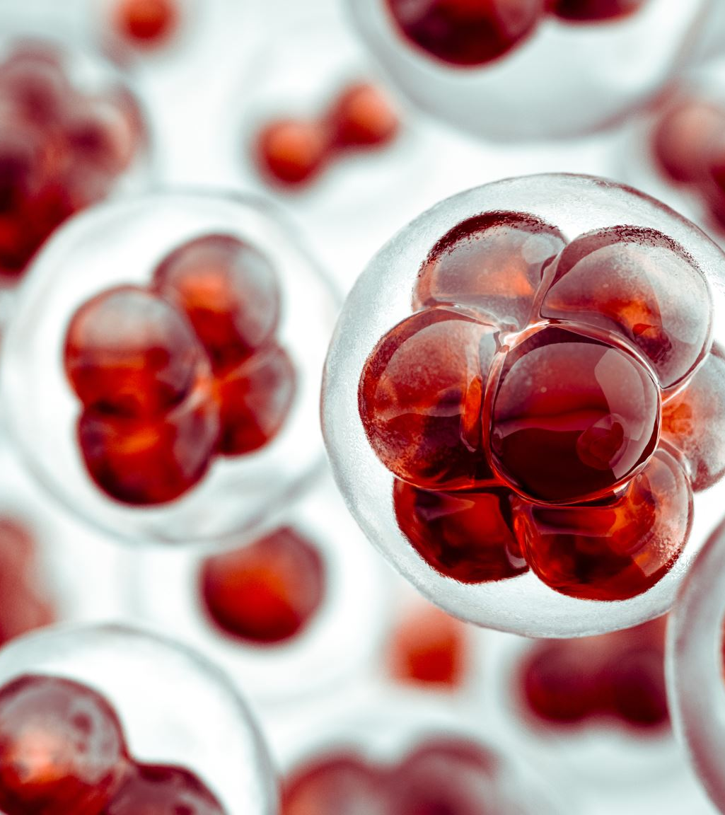
protease
Protease is an enzyme that breaks down proteins into smaller peptides and amino acids.
It is widely used in various industries, especially in detergents for its ability to digest protein-based stains like blood, sweat, grass, food, and egg
They are usually produced industrially using fermentation from Bacillus subtilis.

Slide 2
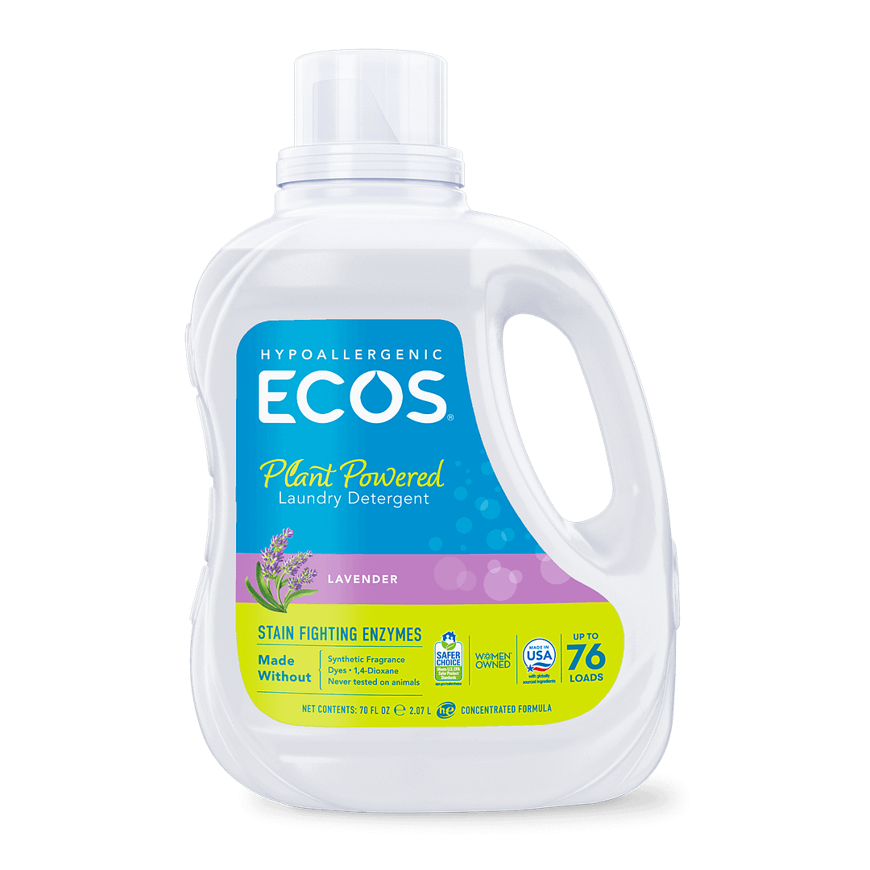
ROLE IN DETERGENT INDUSTRY
Proteases are added as active ingredients to improve stain removal.
Protease Enzyme in detergent and laundry industry are used for over fifty years to facilitate the discharge of super molecule materials in stains like those of milk and blood. The super molecule dirt coagulates on the material within the absence of proteinases as a results of laundry conditions.The enzymes take away not solely the plain stains, such as blood, but also other obvious materials including proteins from body secretion and food such as milk, egg, meat and fish. (protein stain)

Slide 3
PROCESS CONDITION
Aeration : Required (aerobic conditions)
Temperature: 30°C – 37°C
pH: Neutral to slightly alkaline (pH 6.5–8.5)
The industry continuously seeks proteases with enhanced stability and novel properties to improve cleaning performance

Slide 4
MY ROLE AS A ENGINEER
As an engineer I can program the environment in which the machine is kept to be in optimal temperature of 30°C – 37°C
If there is a pH imbalance sensed by the pH indicator the machine will come to a halt so as to not to compromise the quality of detergent.

Slide 5
REFERENCE SLIDE
https://www.google.com/imgres?q=detergent%20with%20protease%20as%20a%20ingredient&imgurl=https%3A%2F%2Fmlcvmo0gntjk.i.optimole.com%2Fcb%3AICH-.67306%2Fw%3A1080%2Fh%3A1080%2Fq%3A90%2Ff%3Abest%2Fig%3Aavif%2Fhttps%3A%2F%2Fwww.ecos.com%2Fwp-content%2Fuploads%2F2023%2F05%2F1_LaundryLiquid_Enzymes_Lavender_70oz_Front.png&imgrefurl=https%3A%2F%2Fwww.ecos.com%2Flaundry%2Fhypoallergenic-laundry-detergent-with-enzymes-free-clear%2F&docid=NxV1SYYYu9R-kM&tbnid=pE7a_Ew9WZJqHM&vet=12ahUKEwipmdeJk86PAxX-RmwGHcjnDWUQM3oECGYQAA..i&w=1080&h=1080&hcb=2&ved=2ahUKEwipmdeJk86PAxX-RmwGHcjnDWUQM3oECGYQAA
https://infinitabiotech.com/blog/protease-enzyme/

